Slide 1
Aristocracy noun
The highest class in certain societies, especially those holding hereditary titles or offices.
Singular Form: Aristocrat
Plural Form: Aristocracy, Aristocrats

Slide 2
Aristocracy
Pericles was a leader of ancient Greece.
Pericles was part of the ancient Greek aristocracy.
The aristocracy was in charge of ancient Greece.

Slide 3
Aristocracy: Examples in the US

Slide 4
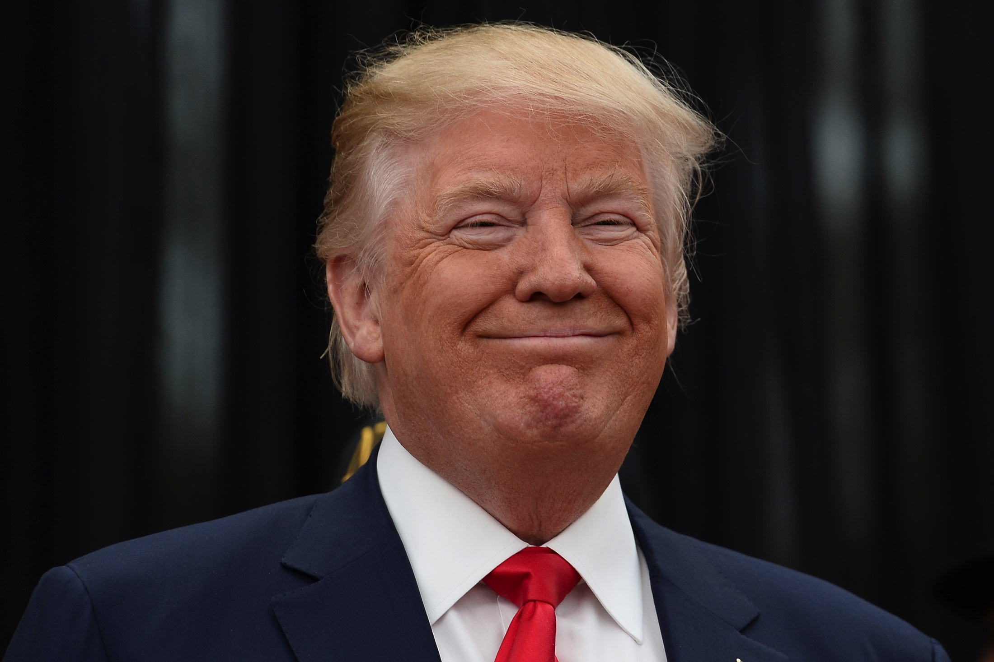

Slide 5
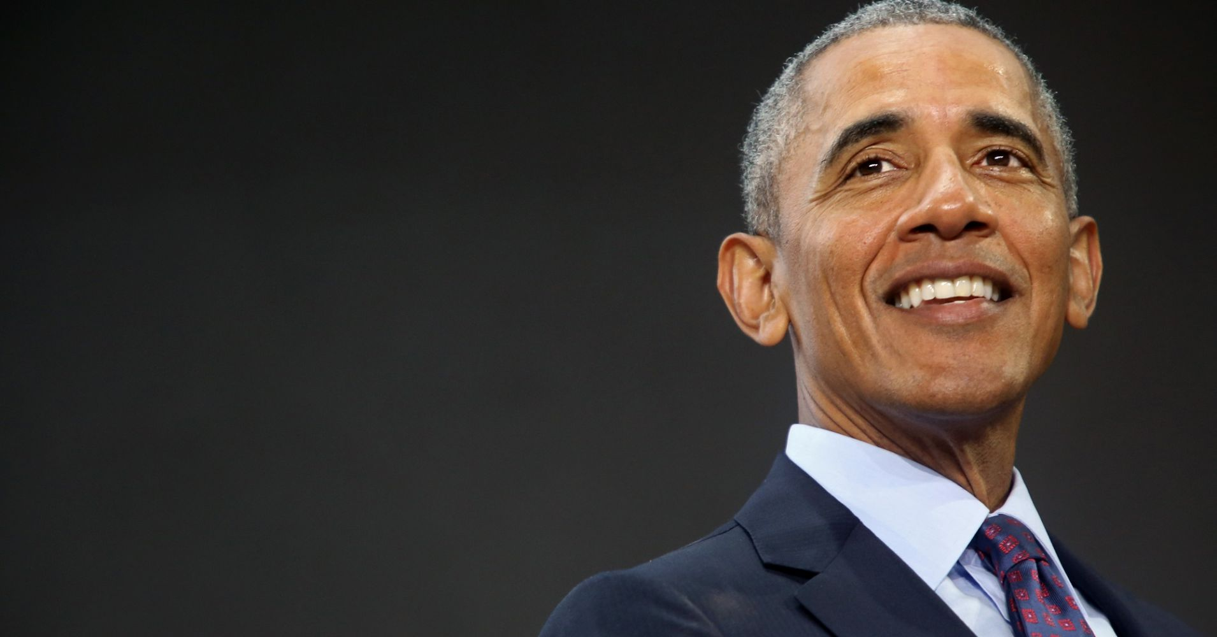

Slide 6
Better Examples:

Slide 7
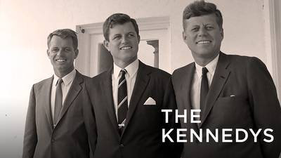
The Kennedy family is an American political family that has long been prominent in American politics, public service, entertainment and business. The first Kennedy elected to public office was Patrick Joseph "P. J." Kennedy in 1884, 35 years after the family's arrival from Ireland. He served in the Massachusetts state legislature from 1884 to 1895. At least one Kennedy family member served in federal elective office in every year from 1947, when P.J. Kennedy's grandson, John F. Kennedy, became a member of Congress from Massachusetts; to 2011, when P.J. Kennedy's great-grandson, Patrick J. Kennedy, retired as a member of Congress from Rhode Island, a span of 64 years.

Slide 8
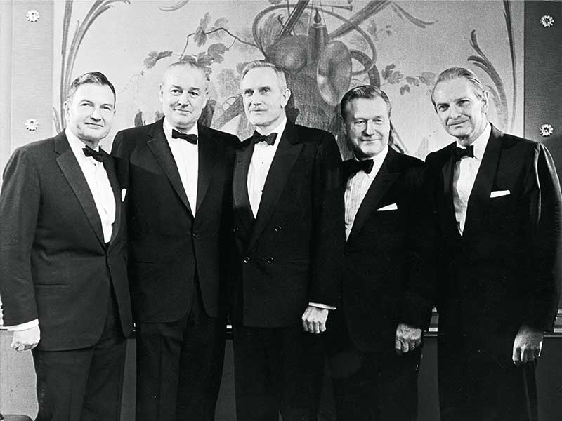
The Rockefellers
The Rockefeller family is an American industrial, political, and banking family that owns one of the world's largest fortunes. The fortune was initially made in the US petroleum industry during the late 19th and early 20th centuries by John D. Rockefeller and his brother William Rockefeller, primarily through Standard Oil. The family is also known for its long association with, and control of, Chase Manhattan Bank. They are considered to be one of the most powerful families, if not the most powerful family, in the history of the United States.

Slide 9
Aristocracy: Examples we’ve already learned about

Slide 10
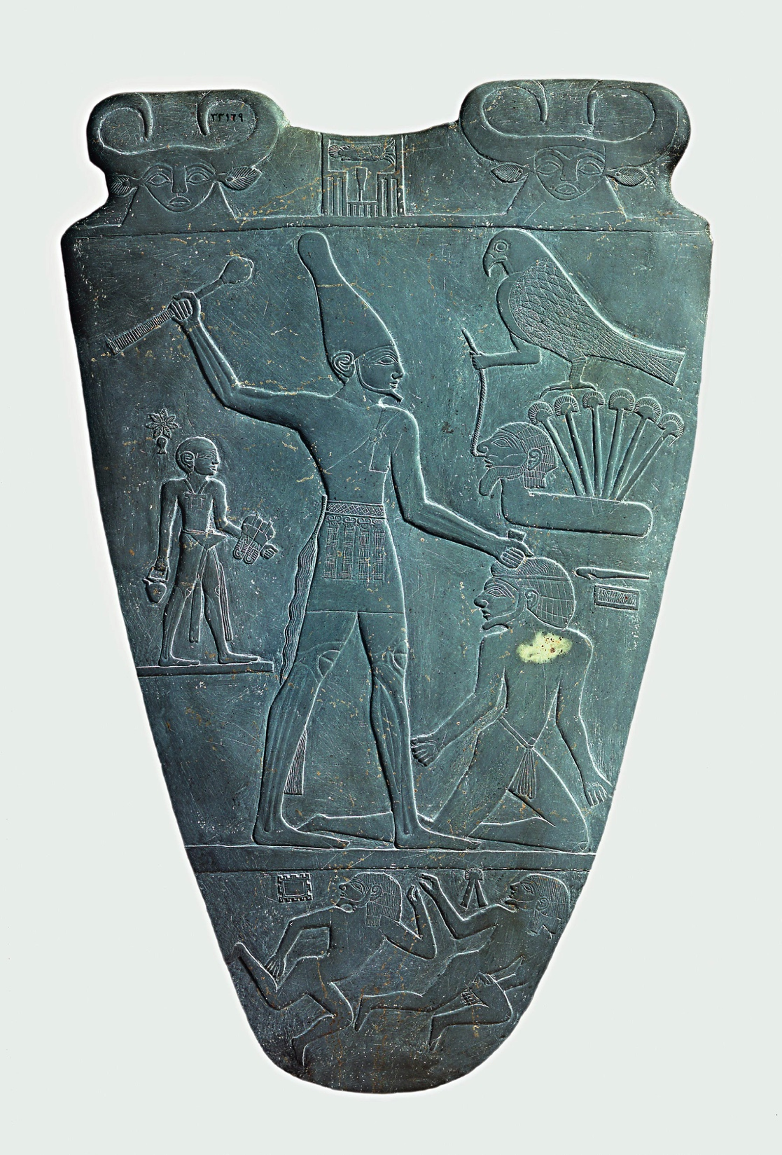
King Narmer

Slide 11
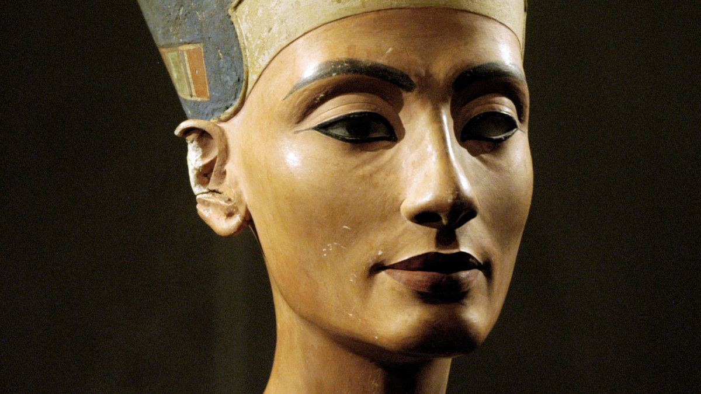
Nefertiti

Slide 12
Examples in ancient Greece

Slide 13
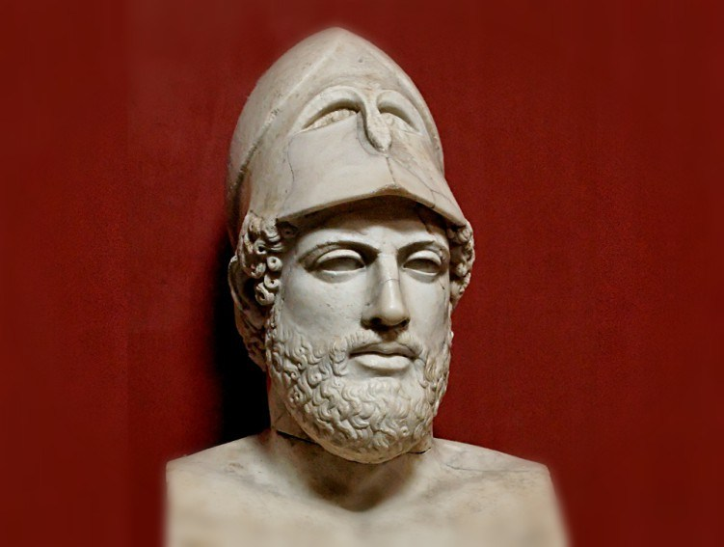
Pericles

Slide 14
Non examples in the US

Slide 15
Wealthy? Yes, lot’s of political power, not so much. One could argue
Their political opinions could influence more powerful people, but they
do not directly have political influence.

